Slide 1


Hawaii State trade expansion program (HiSTEP)
Funded in part through a cooperative agreement with the U.s. small business administration (SBA)
The program is administered by the Department of Business, Economic Development and Tourism (DBEDT) which partners with several agencies and organizations to carry out HiSTEP including:
Hawaii Pacific Export Council
U.S. Department of Commerce, Export Assistance Center
Small Business Development Centers
Innovate Hawaii (High Technology Development Corporation)
SBA Hawaii District Office
Hawaii Department of Agriculture
Foreign Trade Zone No. 9.

Slide 2
What is HiSTEP? http://invest.hawaii.gov/exporting/histep/
The Hawaii State Trade Expansion Program (HiSTEP) has three integrated components:
HiSTEP – Export Readiness Training (HiSTEP-ERT): A series of training programs that prepare Hawaii companies to begin or expand their export market development.
HiSTEP – Hawaii Pavilions (HiSTEP-HP): DBEDT organizes groups of Hawaii companies to participate in major trade shows in a Hawaii pavilion to introduce potential buyers and distributors.
HiSTEP – Company Assistance (HiSTEP-CA): Direct financial assistance for export market development costs

Slide 3
HiSTEP – Export Readiness Program (HiSTEP-ERP)
A series of training programs that prepare Hawaii companies to begin or expand their export market development.
A foundation program open to all types of businesses considering exporting
Sessions will cover general background as well as country- and issue-specific topics
At conclusion of program, companies will have a go-to-market strategy and export plan
Eleven different training sessions are scheduled between February to August 2017; check the HiSTEP website (http://invest.hawaii.gov/exporting/histep/) for specific topics and dates.

Slide 4
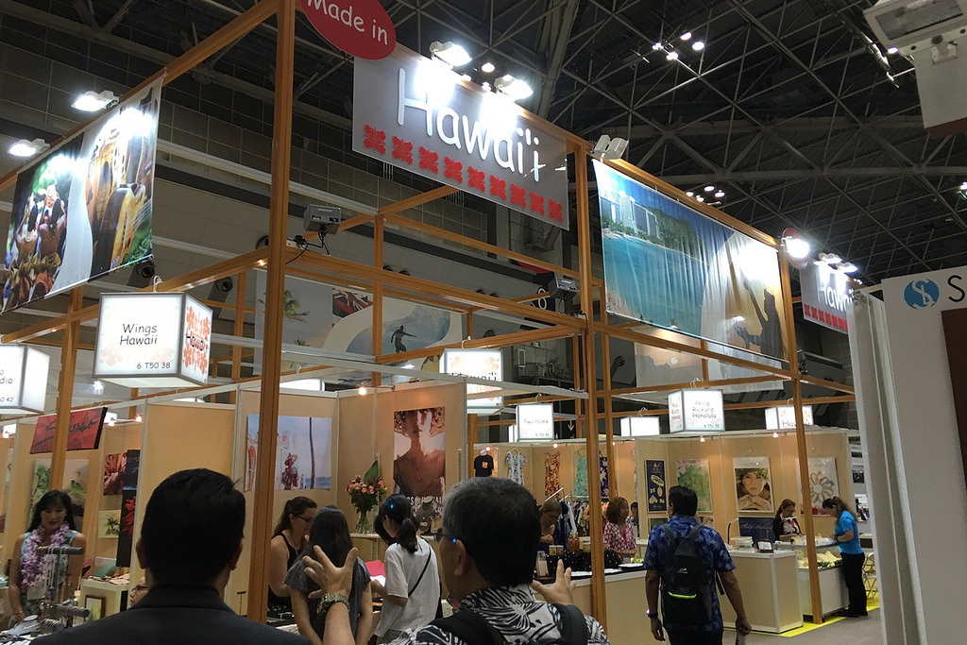
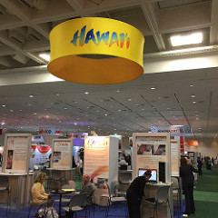
HiSTEP – Hawaii Pavilions (HiSTEP-HP)
DBEDT and partners such as the Hawaii Department of Agriculture organize groups of Hawaii companies to participate in major trade shows in a Hawaii pavilion. Visit the HiSTEP website for events and dates (http://invest.hawaii.gov/exporting/histep/).
BIO International Convention
International Food Ingredients and Additives Show Tokyo, Japan
Tokyo International Gift Show

Slide 5
HiSTEP – COMPANY Assistance (HiSTEP-CA)
Assists individual Hawaii companies with export market development costs.
Proposals may request a minimum of $5,000 and a maximum of $15,000
The program RFP has already been posted and can be downloaded at: http://spo3.hawaii.gov/notices/notices/rfp-17-01-bdsd.
Applications are being accepted in three rounds (or until funds are depleted). Round One deadline has passed. Remaining deadlines:
  Round Two: February 10, 2017 by 12:00 p.m.
  Round Three: March 17, 2017 by 12:00 p.m.

Slide 6
HiSTEP-ca Award Funds will be Limited to the Following Uses
Airfare (consistent with Fly America guidelines) to approved trade show(s) or multiple buyer meetings (minimum 6 meetings) or to attend a HiSTEP Export Readiness Training Session;
Trade show booth rental or trade mission participation fee;
Trade show booth build-out or other booth-related (e.g., interpreter services) expenses ($3,000 maximum);
Shipping of products to the trade show and return;
Gold Key Service or other federal export development programs;

Slide 7
HiSTEP-ca Award Funds will be Limited to the Following Uses (Continued)
Localization services for collateral materials and website ($3,000 maximum);
Fees for shipping sample products ($2,000 maximum);
Cost of compliance testing an existing product for entry into an export market ($2,000 maximum);
Export Research Tool Subscription used to assist company with market research ($1,000 maximum).

Slide 8
Success Metrics for HiSTEP
1) Expanded exports and revenue from exports of Hawaii produced goods and services
2) A larger overall number and a larger percentage of Hawaii-based companies that are active in global markets
3) Penetration of new markets for Hawaii produced goods and services

Slide 9
Eligibility for HiSTEP
Companies wishing to participate in any of the HiSTEP activities must meet at least the following requirements
1. Meet the federal requirements of an ‘eligible small business concern’ (organized or incorporated and operating in the U.S., meet SBA size standards, one year in business, profitable, has access to sufficient resources to bear the costs associated with trade).
2. Certify that the company is not barred from receiving federal funds.
3. Be registered in good standing with the State Department of Commerce and Consumer Affairs’ Business Registration Division.
4. Have a current general excise tax license with the State Department of Taxation.

Slide 10
My company is eligible.
What do I do now?
Visit the HiSTEP website http://invest.hawaii.gov/exporting/histep/
and complete the online application.

Slide 11
Questions?
Jamie Lum
Economic Development Specialist
Phone: 808-587-2753 Fax: 808-586-2589
jamie.k.lum@hawaii.gov
Mark Ritchie
Program Manager – Business Support
Phone: 808-587-2785 Fax: 808-586-2589
mark.j.ritchie@hawaii.gov
Business Development and Support Division
State of Hawaii, Dept. of Business, Economic Development & Tourism
http://invest.hawaii.gov/exporting/histep/

